Slide 1



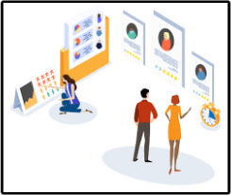
Capstone Project
Power BI
HR DATA
Team members:
K J R Krithika
Rabab
Samyuktha
Mansi
Date: 7th September 2023

Slide 2

Table of
CONTENTS
01
02
03
04
Overview
KPI’s (Key Performance Indicators)
Employee Data
Employee Qualification Data
05
06
07
08
Salary Data
Satisfaction level Data
Employee’s Worklife Data
Insights

Slide 3

INTRODUCTION
HR Data is basically the process of collecting and analyzing Human Resource (HR) data in order to improve an organization’s workforce performance.
Also called as Talent analytics, People analytics or even Workforce analytics.
It is any personal data relating to Data Subjects in the sense of staff members, i.e. employees, candidates, trainees, temporary workers, or retirees.
This data collected mainly focuses on the attrition of the employees at the company and is arranged in the relevant order.

Slide 4
KPI’S
6.50K AVERAGE MONTHLY INCOME | 1470 TOTAL EMPLOYEES | 237 TOTAL EMPLOYEES (YES TO ATRRITION) | 1233 TOTAL EMPLOYEES (NO TO ATRRITION)
87 TOTAL NO. OF FEMALES (YES TO ATRRITION) | 732 TOTAL NO. OF MALES (NO TO ATTRITION) | 501 TOTAL NO. OF FEMALES (NO TO ATRRITION) | 150 TOTAL NO. OF MALES (YES TO ATRRITION)

Slide 5
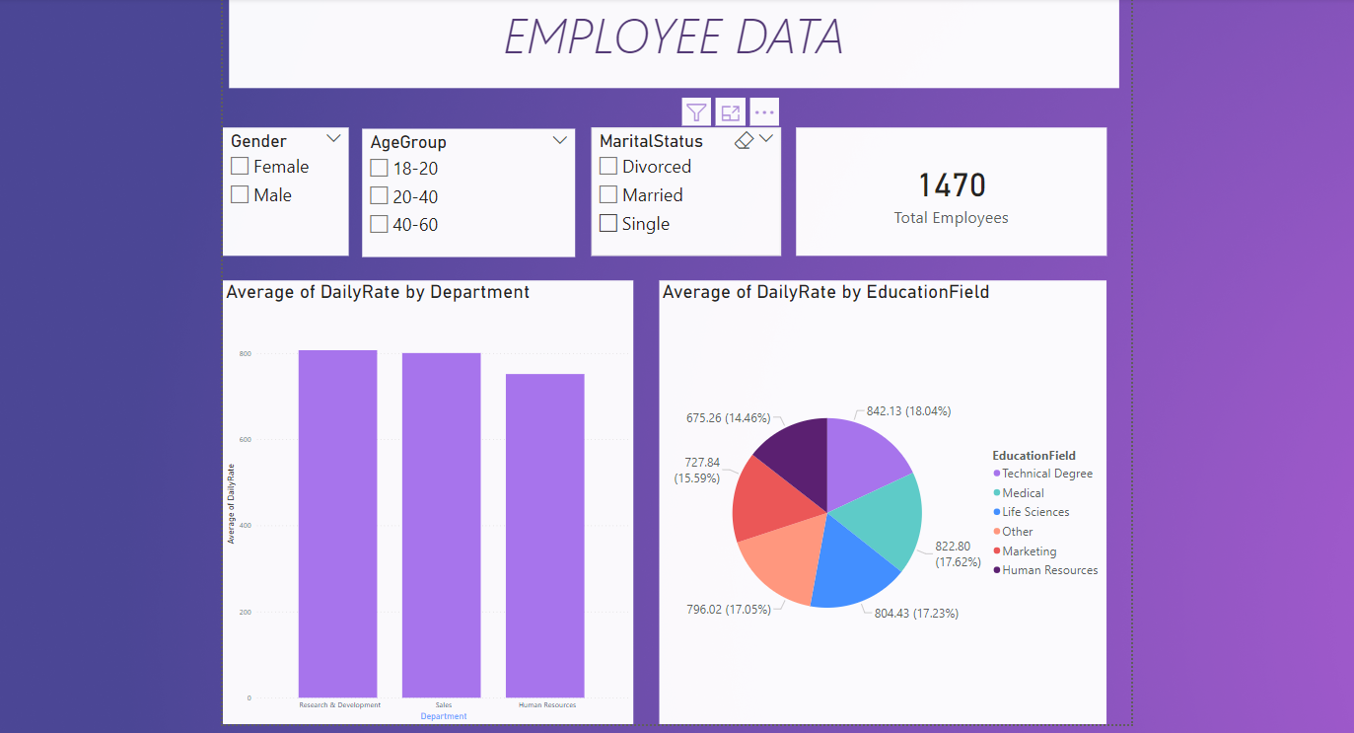

Slide 6
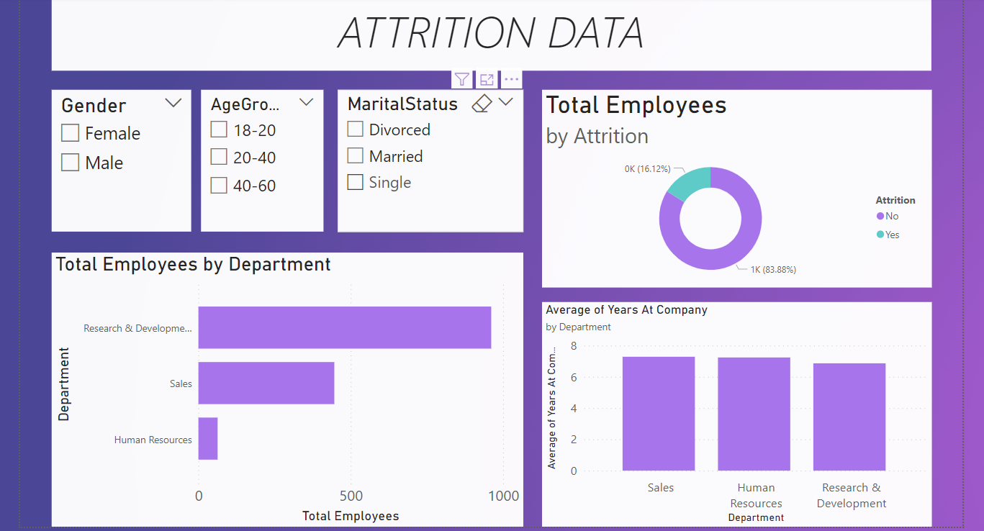

Slide 7
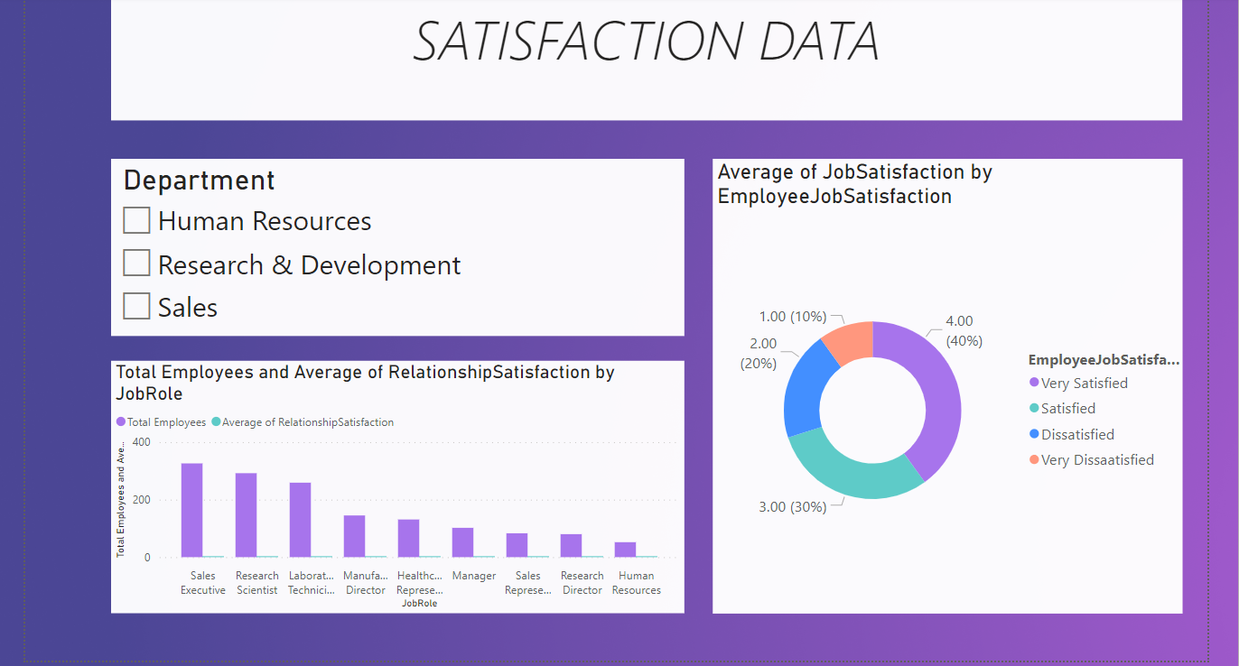

Slide 8
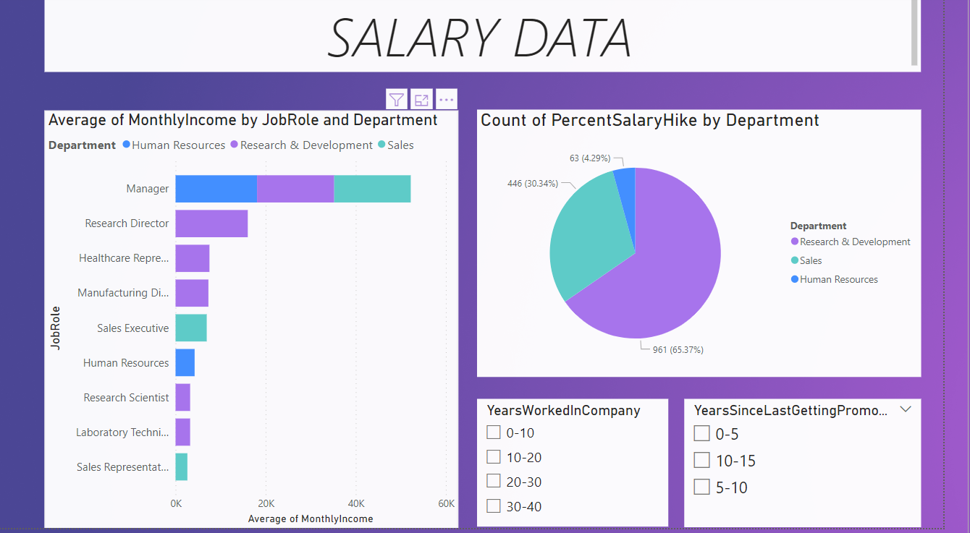

Slide 9

The Attrition rate is approximately 16.12%, which means that about 16.12% employees are considering or planning to leave the organization. The organization should continue to monitor and take proactive steps to reduce attrition. The organization may focus on recruitment efforts to fill vacant positions.
To improve employee retention, the organization should consider implementing retention strategies & attract and retain top talent, the organization should frequently review its organization structure to ensure it remains competitive within the industry.
The organization should evaluate its salary increase policies to align with the market trends and employee's expectations.
Regularly benchmarking the performances of HR Metrics against the industry standards can provide valuable insights into where are improvements are needed.
INSIGHTS

Slide 10


THANK YOU
United Network of Professionals
krithi224.raj@gmail.com
+91 9014226982

